Slide 1
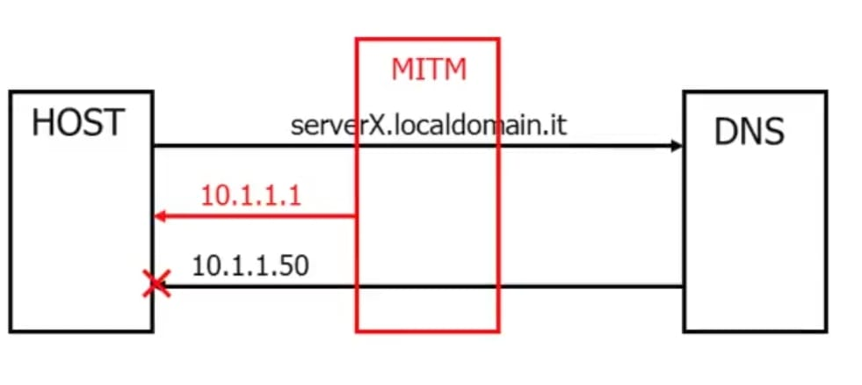
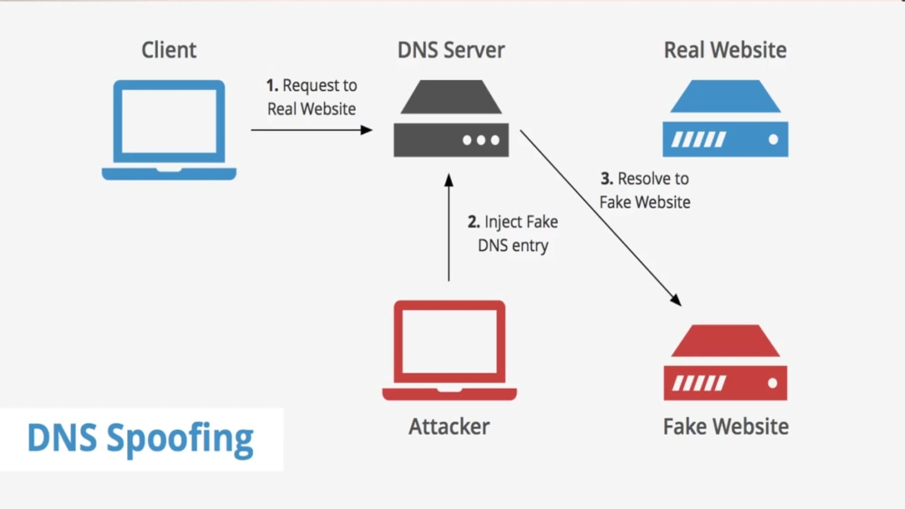

DNS Security: Zone Transfer, DNSSEC, and Hardening
This lab focuses on hands-on DNS security assessment and mitigation techniques. We will use Kali Linux as the attacker and Windows Server as the victim. The DNS zone for this lab is wipro.local.
28811-Anuj Sen
DNS Spoofing Redirected to Malicious Domain

Slide 2





Lab Setup and DNS Security Overview
Attacker
Victim
Concerns
Kali Linux with tools like dig, nslookup, dnsrecon.
Windows Server 2022 running DNS service, wipro.local configured.
Zone Transfers, DNS Spoofing/Cache Poisoning, DDoS attacks.
Defense
DNSSEC, Access Control Lists (ACLs), Monitoring.
Understanding the setup and common threats is crucial for effective DNS security.

Slide 3
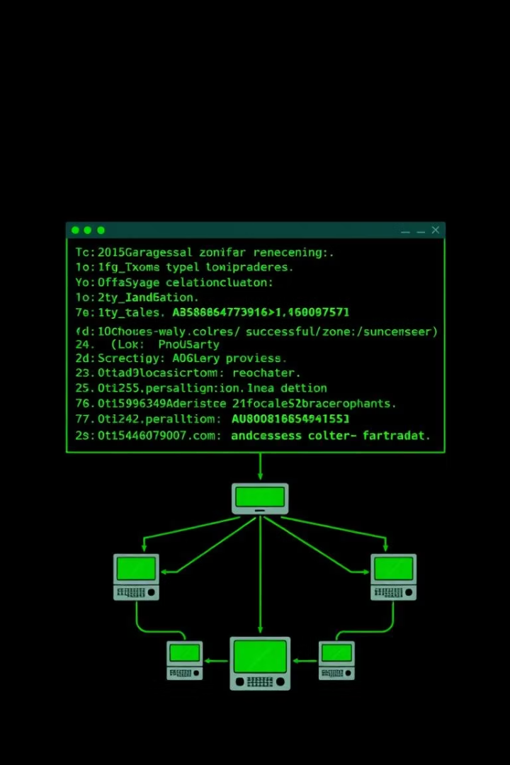



Zone Transfer Attack (Offensive)
Objective
Retrieve entire DNS zone file from wipro.local.
Kali Linux Steps
dig axfr wipro.local @192.168.205.128
nslookup: Use ls -d wipro.local
dnsrecon -d wipro.local -t axfr
Expected Outcome
Successful transfer reveals hostnames, IPs, and DNS structure.
These commands illustrate how an attacker can leverage misconfigured DNS servers to gain valuable network information.

Slide 4



Zone Transfer Protection (Defensive)
DNS Manager
Access properties of DNS server -> Zone Transfers.
Disable/Restrict
Disable or restrict "Allow Zone Transfers" to authorized servers only.
ACLs
Specify allowed IPs/networks for zone transfers.
Proper configuration on the Windows Server is crucial to prevent unauthorized zone transfers. Regular audits reinforce security.

Slide 5
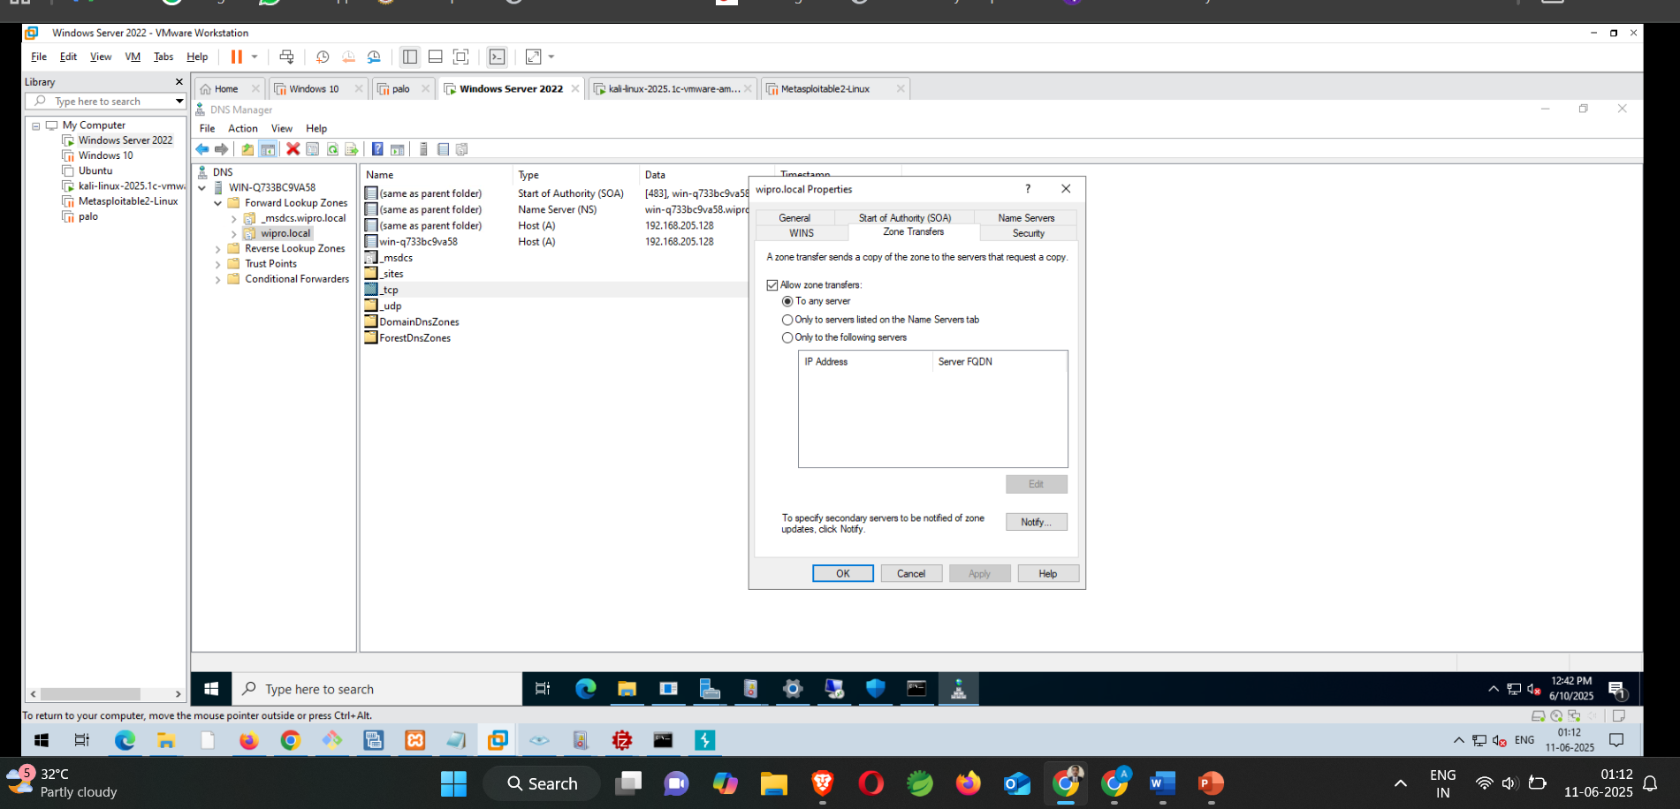
Click on Start -> DNS -> Forward Lookup Zones -> Right click wipro.local -> Properties -> Zone Transfer

Slide 6








Implementing DNSSEC (Defensive)
Sign the Zone
Configure Parameters
Right-click wipro.local zone in DNS Manager -> DNSSEC.
Use recommended defaults like RSA/SHA-256 for signing.
Publish Records
Generate Keys
Distribute trust anchors (DS records) for validation.
Create Key Signing Key (KSK) and Zone Signing Key (ZSK).
DNSSEC adds a layer of cryptographic security to DNS data. It ensures data authenticity and integrity against tampering.

Slide 7
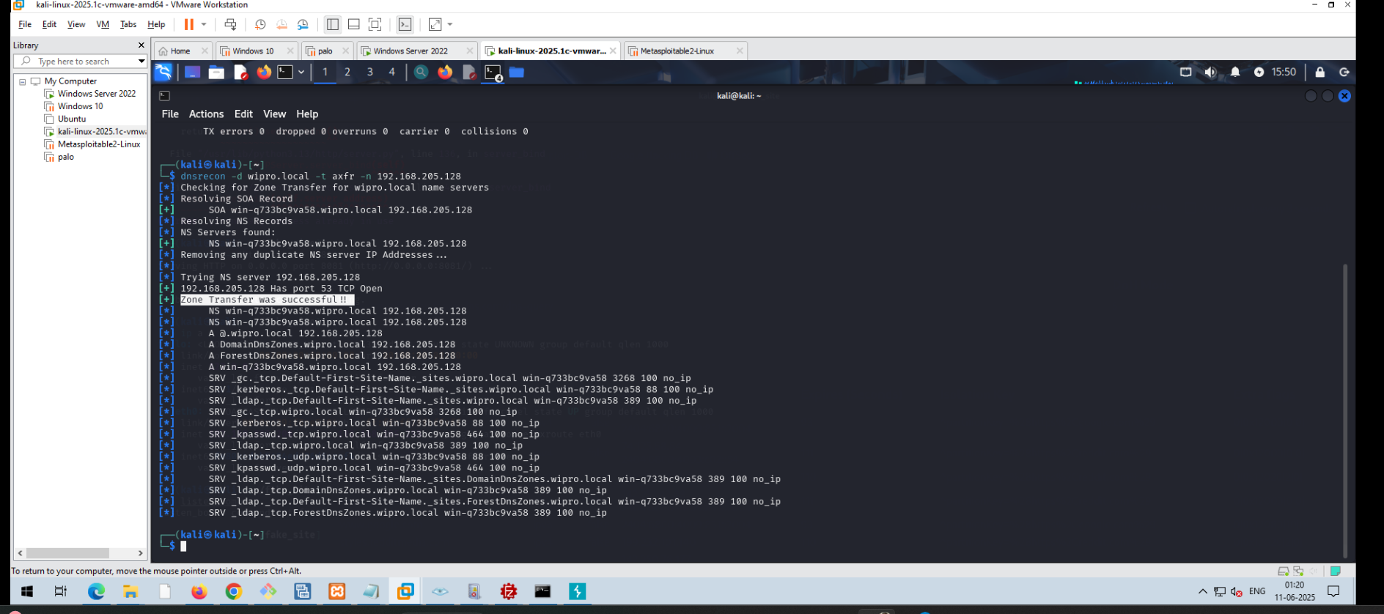
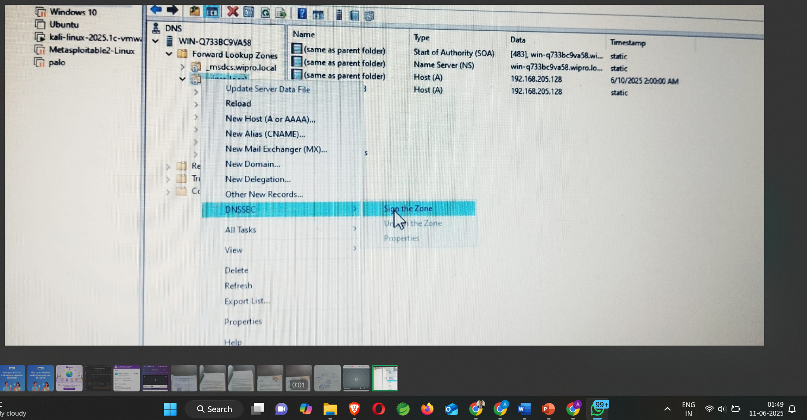
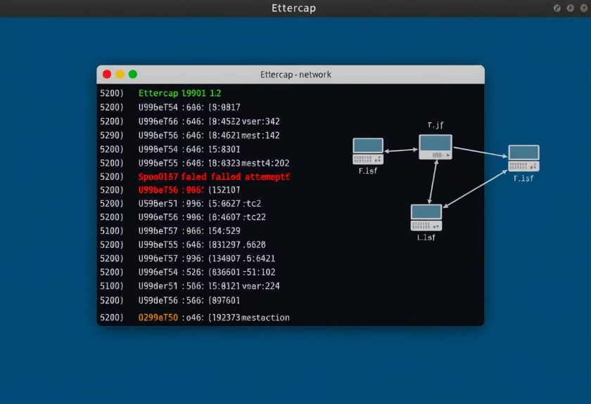
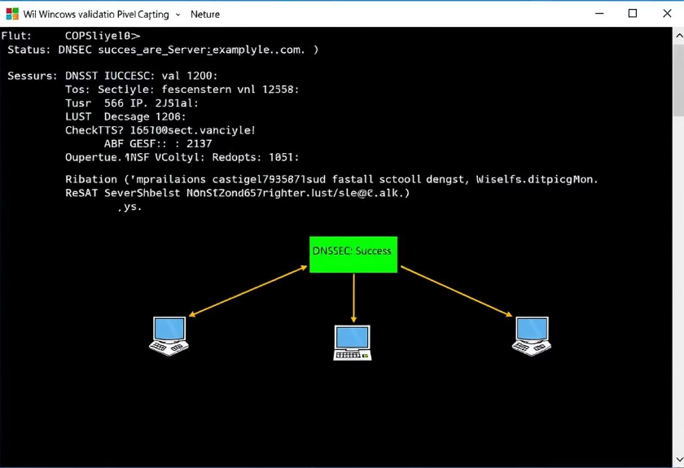
DNSSEC Validation (Offensive/Defensive)
Offensive (Kali)
Defensive (Windows)
Attempt DNS spoofing using tools like ettercap and arpspoof. Observe failed validation.
Ensure DNSSEC validation is enabled on resolvers. Use PowerShell command: Get-DnsClientGlobalSetting.
Validation is key to DNSSEC's effectiveness. Attackers will fail when validation is active.

Slide 10





DNS Security Monitoring and Detection
Server Logging
Enable DNS server logging for zone transfers, DNSSEC failures.
SIEM Integration
Forward DNS logs to a SIEM system for analysis.
IDS Rules
Implement rules in IDS (e.g., Snort) to detect malicious queries.
Regular Audits
Conduct periodic security assessments of DNS infrastructure.
Comprehensive monitoring and logging are vital for early detection of DNS-related security incidents.

Slide 11

Conclusion
DNS Criticality
Key Threats
DNS security is critical for network integrity and confidentiality.
Zone transfers, DNS spoofing, and DDoS are significant threats.
DNSSEC Value
Proactive Defense
DNSSEC provides strong authentication and data integrity.
Monitoring, logging, and regular audits are essential for hardening Windows DNS servers using ACLs for Zone Transfers.
Effective DNS security requires a multi-layered approach, combining prevention, detection, and ongoing maintenance.

